Slide 1
SRS port grouping for foldable phone

Slide 2
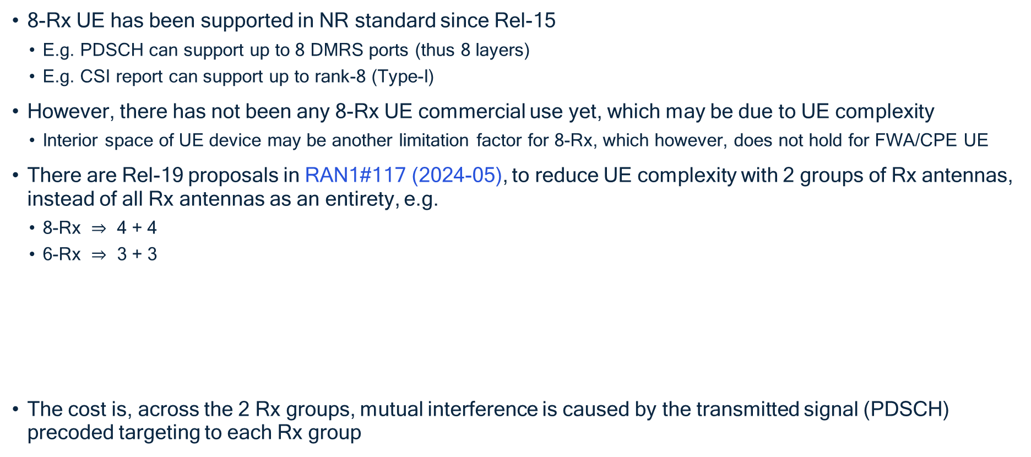
Background: Rel-19 RAN1 proposal (by other companies)
8-Rx UE has been supported in NR standard since Rel-15
E.g. PDSCH can support up to 8 DMRS ports (thus 8 layers)
E.g. CSI report can support up to rank-8 (Type-I)
However, there has not been any 8-Rx UE commercial use yet, which may be due to UE complexity
Interior space of UE device may be another limitation factor for 8-Rx, which however, does not hold for FWA/CPE UE
There are Rel-19 proposals in RAN1#117 (2024-05), to reduce UE complexity with 2 groups of Rx antennas, instead of all Rx antennas as an entirety, e.g.
8-Rx $⇒$ 4 + 4
6-Rx $⇒$ 3 + 3
The cost is, across the 2 Rx groups, mutual interference is caused by the transmitted signal (PDSCH) precoded targeting to each Rx group
Proposal 1.A.2: For a UE configured with a total of P_{SRS}=6 or 8 ports across ≥1 SRS resources for antenna switching intended for xT6R or xT8R, respectively, support the following fixed SRS port grouping where (with the P_{SRS} ports indexed in an ascending order according to SRS resource ID and port number within each SRS resource):
SRS port group 0, corresponding to CW0, comprises the first P_{SRS}/2 out of P_{SRS} ports; and
SRS port group 1, corresponding to CW1, comprises the second P_{SRS}/2 out of P_{SRS} ports
FFS: Impact of the above grouping on CQI calculation, if any
Note: different SRS ports are associated with different UE antenna ports.
Note: if one single CW is scheduled, both SRS port groups can correspond to the same CW
Note: This feature is a separate UE capability and, for UEs supporting this capability, configured via RRC (FFS details on the extend of RRC configuration)

Slide 3
Background: 2-CW and single-CW receiving
Reduced complexity MIMO receiver via two Rx port groups
For rank>4, 2-CW PDSCH is transmitted targeting each Rx port group respectively – Fig (a)
For rank<=4 (single-CW PDSCH), UE may either use LLR combining from the two Rx port groups’ demodulation – Fig (b)
Or alternatively, UE may simply use one of the two Rx port groups (fixed one, or one with better SNR)

Slide 4
Background: SRS for antenna switching (xTyR)
In an SRS resource set (with parameter “usage” configured as “antenaSwitching”) for xTyR, there are Q=y/x SRS resources each having x ports
The Q SRS resources are transmitted in different symbols (TDM)
Each of the Q SRS resources is associated with different UE antenna port(s) than the other Q-1
For all cases specified until now, y is an integer multiples of x, e.g. 1T2R, 2T4R, 1T4R, 2T6R, 4T8R (or some cases with x=y e.g. 1T=1R, 2T=2R, 4T=4R)
Although, some case violating such integer-multiple-principle may be developed in future, e.g. 4T6R, 3T8R

Slide 5
Motivation and issue
Besides possible MIMO receiver complexity reduction, another use case of SRS port grouping is for foldable phone
The two Rx antenna groups (correspond to the two SRS port groups) are mounted on the two “halves” of the foldable phase, respectively
Generally, RF circuitry can’t cross the hinge
Issue: For foldable phone/UE, how to design SRS port grouping (e.g. for 3T6R/4T6R/3T8R UE, besides what have been covered by previous filing 2404951, as summarized in Appendix)?

Slide 6
Proposal for 3T6R
The grouping of the x=3 Tx antenna ports is split as 1+2
The grouping of the y=6 Rx antenna ports is split as 2+4 (not 3+3)
The grouping of the Q=2 SRS resources (each x=3 ports) in an SRS resource set is split as: Group#0 and group#1 ports as {SRS#0[0,1,2], SRS#1[0,1,2]}
1st half of a foldable phone (SRS port group#0) | 2nd half of a foldable phone (SRS port group#1)
SRS#0[0], SRS#1[0] | SRS#0[1,2], SRS#1[1,2]

Slide 7
Proposal for 4T6R
Alt2 SRS: 2 SRS resources in a set,
SRS#0: 4 ports
SRS#1: 4 ports (thus overlapped antenna ports)
The grouping of the 2 SRS resources in an SRS resource set is split as: Group#0 and group#1 ports as {SRS#0[0,1,2,3], SRS#1[0,1,2,3]}, where “overlap” antenna port (i.e. different combination of {SRS resource index, SRS port index} associated with a same antenna port) should be defined/configured (e.g. {SRS#0, port#0} and {SRS#1, port#0} have a same antenna port; Similarly for port#2)
Alt1 SRS: 2 SRS resources in a set,
SRS#0: 4 ports
SRS#1: 2 ports
The grouping of the 2 SRS resources in an SRS resource set is split as: Group#0 and group#1 ports as {SRS#0[0,1,2,3], SRS#1[0,1]}
1st half of a foldable phone (SRS port group#0) | 2nd half of a foldable phone (SRS port group#1)
SRS#0[0,1], SRS#1[0] | SRS#0[2,3], SRS#1[1]
1st half of a foldable phone (SRS port group#0) | 2nd half of a foldable phone (SRS port group#1)
SRS#0[0,1], SRS#1[0,1] | SRS#0[2,3], SRS#1[2,3]
For both Alt1 and Alt2, the grouping of the y=6 antenna ports is split as 3+3

Slide 8
Proposal for 3T8R (Alt1)
The grouping of the x=3 Tx antenna ports is split as 1+2
The grouping of the y=6 antenna ports is split as 3+5 (not 4+4)
Alt1 SRS: 3 SRS resources in a set: SRS#0: 3 ports; SRS#1: 3 ports; SRS#2: 2 ports (non-overlap ports)
For Alt1, the grouping of the 3 SRS resources in an SRS resource set is split as: Group#0 and group#1 ports as {SRS#0[0,1,2], SRS#1[0,1,2], SRS#2[0,1]}
1st half of a foldable phone (SRS port group#0) | 2nd half of a foldable phone (SRS port group#1)
SRS#0[0], SRS#1[0], SRS#2[0] | SRS#0[1,2], SRS#1[1,2], SRS#2[1]

Slide 9
Proposal for 3T8R (Alt2)
Alt2 SRS: 3 SRS resources in a set: SRS#0: 3 ports; SRS#1: 3 ports; SRS#2: 3 ports (thus overlap ports)
The grouping of the Q=2 SRS resources (each x=3 ports) in an SRS resource set is split as: Group#0 and group#1 ports as {SRS#0[0,1,2], SRS#1[0,1,2], SRS#1[0,1,2]}
“Overlap” port (i.e. different combination of {SRS resource index, SRS port index} associated with a same antenna port) should be defined/configured (e.g. {SRS#0, port#1} and {SRS#2, port#1} have a same antenna port)
1st half of a foldable phone (SRS port group#0) | 2nd half of a foldable phone (SRS port group#1)
SRS#0[0], SRS#1[0], SRS#2[0] | SRS#0[1,2], SRS#1[1,2], SRS#2[1,2]

Slide 11
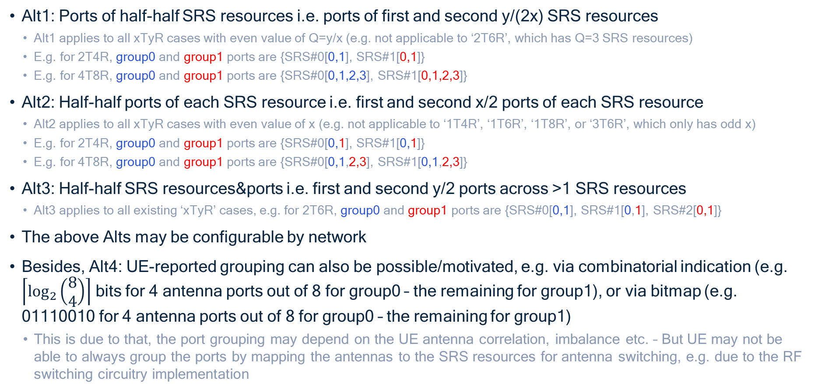
Appendix: SRS port grouping (filed in 2404951)
Alt1: Ports of half-half SRS resources i.e. ports of first and second y/(2x) SRS resources
Alt1 applies to all xTyR cases with even value of Q=y/x (e.g. not applicable to ‘2T6R’, which has Q=3 SRS resources)
E.g. for 2T4R, group0 and group1 ports are {SRS#0[0,1], SRS#1[0,1]}
E.g. for 4T8R, group0 and group1 ports are {SRS#0[0,1,2,3], SRS#1[0,1,2,3]}
Alt2: Half-half ports of each SRS resource i.e. first and second x/2 ports of each SRS resource
Alt2 applies to all xTyR cases with even value of x (e.g. not applicable to ‘1T4R’, ‘1T6R’, ‘1T8R’, or ‘3T6R’, which only has odd x)
E.g. for 2T4R, group0 and group1 ports are {SRS#0[0,1], SRS#1[0,1]}
E.g. for 4T8R, group0 and group1 ports are {SRS#0[0,1,2,3], SRS#1[0,1,2,3]}
Alt3: Half-half SRS resources&ports i.e. first and second y/2 ports across >1 SRS resources
Alt3 applies to all existing ‘xTyR’ cases, e.g. for 2T6R, group0 and group1 ports are {SRS#0[0,1], SRS#1[0,1], SRS#2[0,1]}
The above Alts may be configurable by network
Besides, Alt4: UE-reported grouping can also be possible/motivated, e.g. via combinatorial indication (e.g. $\left\lceil \log_{2}\left(\begin{aligned}8 \\ 4\end{aligned}\right)\right\rceil$ bits for 4 antenna ports out of 8 for group0 – the remaining for group1), or via bitmap (e.g. 01110010 for 4 antenna ports out of 8 for group0 – the remaining for group1)
This is due to that, the port grouping may depend on the UE antenna correlation, imbalance etc. – But UE may not be able to always group the ports by mapping the antennas to the SRS resources for antenna switching, e.g. due to the RF switching circuitry implementation

